Slide 1


Brooklyn Bridge
By Oliver

Slide 2
Measurements
Length=1,090 meters(3,578feet)
Height=84meters (276feet)
Width=85ft

Slide 3

Interesting Facts
It is one of the oldest bridges in the United States.
It connects to New York City boroughs.
It took 14 years to build.

Slide 4

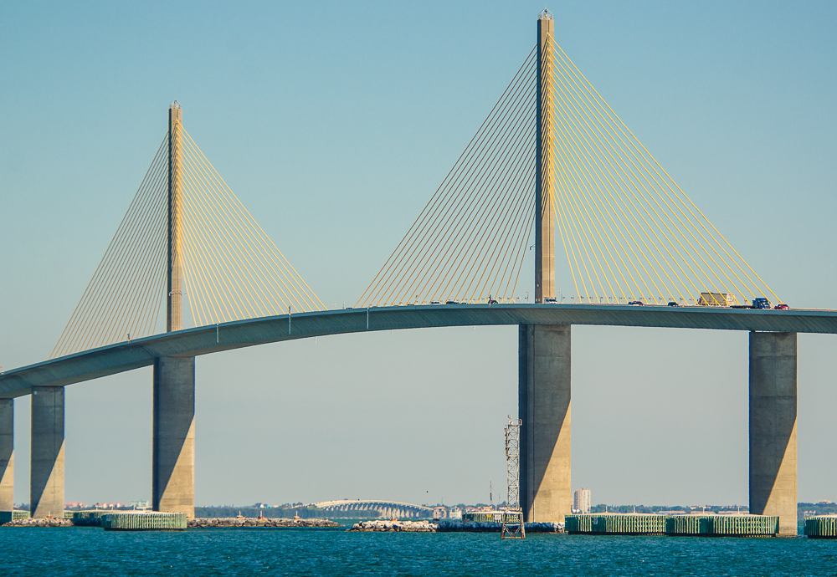
comparison
The Sunshine Skyway Bridge is longer than the Brooklyn Bridge by 25,462 feet

Slide 5


Slide 6
Researched and produced by Oliver 2nd grade Buck Lake Elementary Tallahassee, Florida 2019

